Slide 1
Partnering with DOE on
the Water-Energy Nexus
Resilient Utility Coalition
Visioning Workshop
Alice G. Dasek
U.S. Department of Energy
Miami, FL
August 18, 2016

Slide 2
Overview
DOE and the Water-Energy Nexus
DOE Programs
Better Plants
Superior Energy Performance
Technical Assistance Offerings
Better Buildings Accelerators
Wastewater Infrastructure
CHP for Resiliency

Slide 3
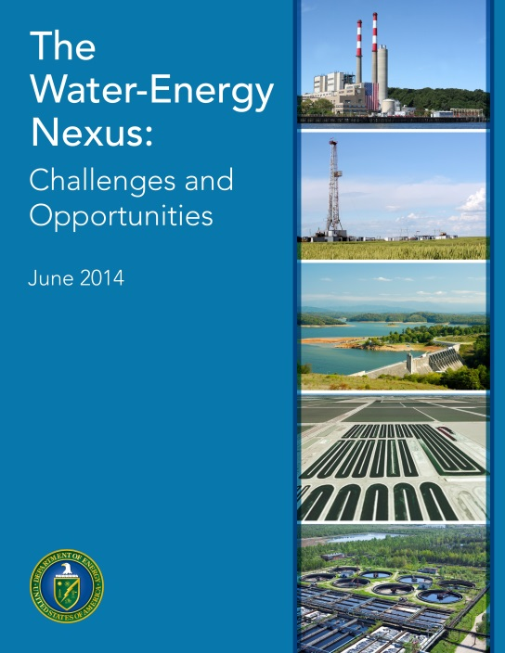
DOE and the Water-Energy Nexus
Search: DOE WETT
The US Department of Energy
Has expertise in technology, modeling, analysis, and data
Undertakes work that has broad and deep implications
Can approach the diffuse water area from the energy side
Download the full Report
Notes:
A couple of years ago, DOE published the comprehensive report shown here.
The report explores the water-energy nexus, looking at both the water requirements in the U.S. power system and the energy challenges in the country’s water system.
It frames the challenges and opportunities in this space and laid the foundation for subsequent DOE efforts and initiatives targeting the water-energy nexus.
Report observations
1. DOE has strong expertise in technology, modeling, analysis, and data and can contribute to understanding the issues and pursuing solutions across the entire nexus.
2. DOE can approach the diffuse water area strongly from the energy side by:
Focusing on its technical strengths and mission, and
Leveraging its strategic interagency connections.
3. DOE’s work has broad and deep implications:
User-driven analytic tools for national decision-making supporting energy resilience with initial focus on the water-energy nexus, and
Solutions through technology RDD&D, policy analysis, and stakeholder engagement.

Slide 4
DOE’s Six Strategic Pillars for the Water-Energy Nexus
Optimize the freshwater efficiency of energy production, electricity generation, and end use systems.
Optimize the energy efficiency of water management, treatment, distribution, and end use systems.
Enhance the reliability and resilience of energy and water systems.
Increase safe and productive use of nontraditional water sources.
Promote responsible energy operations with respect to water quality, ecosystem, and seismic impacts.
Exploit productive synergies among water and energy systems.
Notes:
The report identified six strategic pillars to guide DOE efforts in this space.
The programs from DOE’s Office of Energy Efficiency and Renewable Energy that I’ll be discussing today are centered on Pillars 2, 3, and 6, which focus on improving the energy and carbon efficiency in water and wastewater systems.

Slide 5










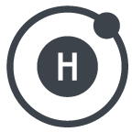
Office of Energy Efficiency and Renewable Energy
EERE Vision
A strong and prosperous America powered by clean, affordable, and secure energy
EERE Mission
To create and sustain American leadership in the transition to a global clean energy economy
Notes:
At the highest level, EERE’s mission is to support the United States’ transition to a global clean energy economy.

Slide 6
EERE’s Guiding Principles: Five Core Questions
Impact
Is this a high-impact problem?
Additionality
Will EERE funding make a large difference relative to existing funding from other sources, including the private sector?
Openness
Are we focusing on the broad problem we are trying to solve and open to new ideas, approaches, and performers?
Enduring Economic Effect
How will EERE funding result in enduring economic impact for the U.S.?
Proper Role of Government
Why is this investment a necessary, proper, and unique role of government?
Notes:
In pursuit of that mission, EERE’s approach is to design a portfolio that will make a significant impact in transforming the national energy landscape and maximizing the value it delivers to the taxpayer.
DOE prioritizes its work according to five core questions dealing with impact, additionality, openness, enduring economic effect, and the proper role of government.
DOE applied these questions when deciding whether to take on a role in the water-energy nexus.

Slide 7
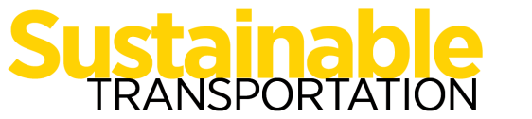
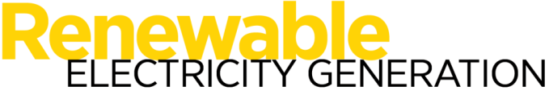


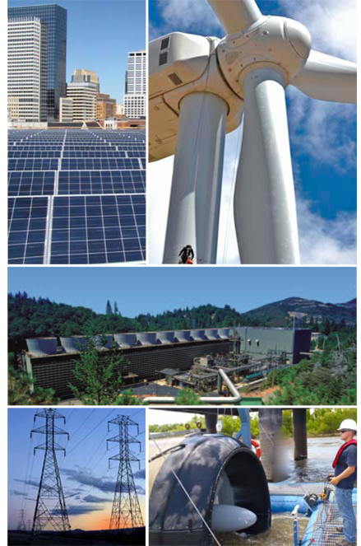
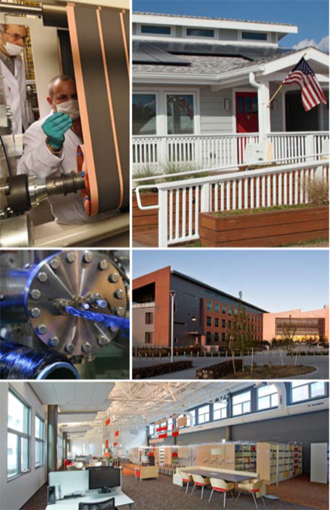
Notes:
It is also important to have an understanding of how EERE is structured.
These are the three divisions in EERE.

Slide 8
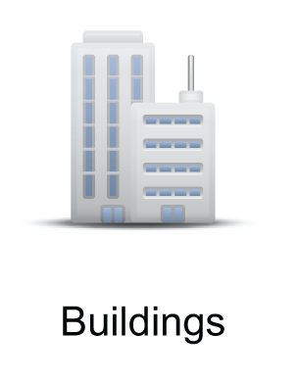
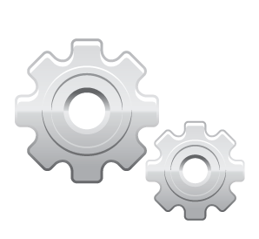
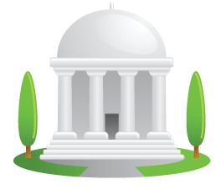

EERE leads a robust network of researchers and other partners to continually develop innovative, cost-effective, energy-saving solutions, which helps make our country run better through increased efficiency – better plants, manufacturing processes, products, new homes, ways to improve older homes, and buildings in which to work, shop, and lead our everyday lives.
Program Offices:
Building Technologies
Office
Advanced Manufacturing
Office
Weatherization &
Intergovernmental
Programs Office
Federal Energy
Management Program
Select Energy Efficiency Accomplishments:
Standards enacted since 2009 are projected to avoid a cumulative total of 2.2 billion metric tons of carbon emissions by 2030
More than 250 DOE partners through the Better Buildings Challenge on track to achieve average energy savings of 2.5% annually and saving 36 TBtus and $300 million since the Better Buildings Challenge began
LED cost reduction – 90% since 2008
Notes:
Most of the offices involved in the water-energy nexus reside in the Energy Saving pillar at DOE. For today’s conversation, the focus are the two program offices listed in the middle here:
1. Building Technologies Office: Leads a vast network of research and industry partners to continually develop innovative, cost-effective energy saving solutions.
2. Advanced Manufacturing Office: Partners with industry, small businesses, universities, and other stakeholders to identify and invest in emerging technologies with the potential to create high-quality domestic manufacturing jobs and enhance the global competitiveness of the U.S.
3. Weatherization & Intergovernmental Programs Office: Provides funding and technical assistance to its partners in state and local governments, Indian tribes, and international agencies to facilitate the adoption of renewable energy and energy efficiency technologies.
3. Federal Energy Management Program: Provides services, tools, and expertise to Federal agencies to help them achieve their legislated and executive-ordered energy, greenhouse gas, and water goals.

Slide 9




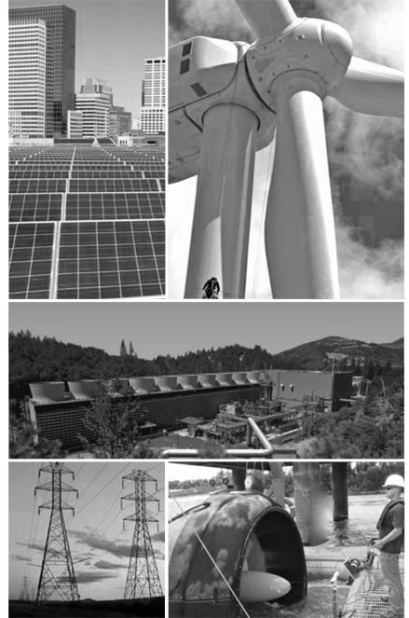

EERE Crosscutting Initiatives
Within our technology office budgets, EERE organizes and coordinates investments across our technology sectors around common themes to achieve maximum impact for the U.S. taxpayer.
Notes:
Each of the offices from the previous slide has a core competency that can contribute to the water-energy nexus. In such cases, DOE breaks down silos across EERE offices to address such critical, cross-cutting energy initiatives.
Thus, the work needed to address the water-energy nexus cuts across DOE offices, and various experts from around DOE provide the multi-dimensional perspective and approach that is needed.
Now, I’m going to share more on the impactful initiatives these offices have built over the last few years, and in particular, share some of the opportunities available through some brand-new programs launched last month.

Slide 10



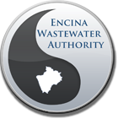
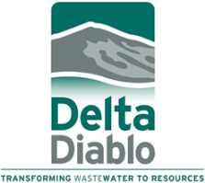
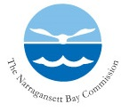

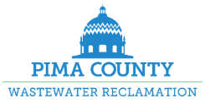

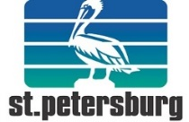
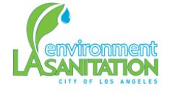
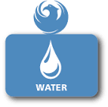
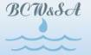
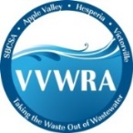
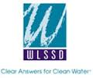

Better Plants – Water Utilities
Industrial arm of the Better Buildings Initiative
19 utilities have joined, 6 in the Challenge
Organizations set long-term efficiency goals
Receive technical assistance and national recognition
Quarterly webinars to share solutions
energy.gov/betterplants
Notes:
Better Plants is the industrial arm of the Better Buildings Initiative—the commitment to achieve at least 20% energy savings in U.S. buildings.
Energy use is similar in water-wastewater and industrial plants, making water-wastewater facilities a good fit for this program. DOE expanded the initiative to these two sectors a couple of years ago.
Partners have two options: (1) Better Plants Program and (2) Better Plants Challenge.
In both, programs facilities make corporate-wide commitments to improve their energy intensity by 25% over 10 years.
Program partners participate in monthly calls and submit an annual, one-page form.
Partners in the Challenge also share their energy performance data and participate in two case studies
Facilities receive technical assistance and national recognition for their successes, particularly for Challenge accomplishments
Current partners include some of the nation’s largest and most complex systems like NY, LA, and Boston.

Slide 11
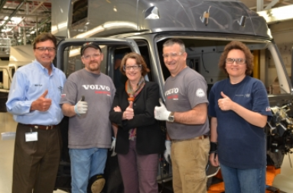
Better Plants – Partner Benefits
Technical Assistance
Peer Networking Opportunities
National Recognition
DOE official poses with Volvo NRV employees
DOE will assign an expert Technical Account Manager, who will help you navigate the program and tap into our energy-saving resources
Notes:
DOE Better Plants partners receive a few, key benefits:
1. TECHNICAL ASSISTANCE:
Is primarily delivered through expert technical account managers.
Technical account managers are DOE contractors that help organizations:
A. Establish energy performance metrics (primary role) – using DOE tools and guidance. DOE is still learning more about specific data challenges this sector faces and look forward to continuing to work with partners and others to refine data protocols.
B. Create energy plans.
C. Connect with additional energy-saving resources.
2. PEER NETWORKING
Takes place at events like the Better Buildings Summit and the World Energy Engineering Congress.
Better Plants partners also have access to less formal mechanisms, such as connecting partner organizations facing the same barrier or problem with each other.
3. NATIONAL RECOGNITION
Partners are recognized when they join, on an annual basis, and when they meet their targets.
DOE also works with trade publications and other media to draw additional attention to partner achievements.

Slide 12
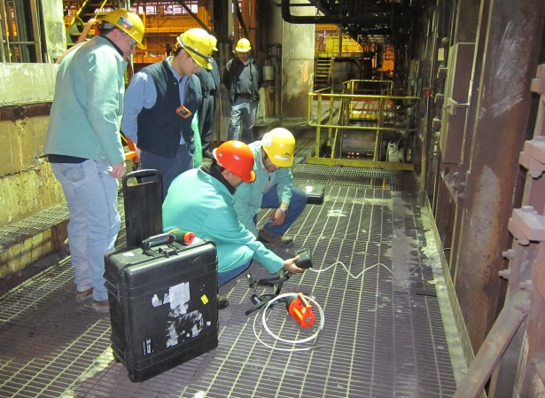
Better Plants – In-Plant Training
Teach participants steps and tools for implementing projects
Are available for the entire supply chain
Webinars available online
Process heating INPLT at an ArcelorMittal plant in Nov. 2013. Photo courtesy ArcelorMittal and ORNL.
Notes:
In-plant trainings are the workforce development technical assistance resource available exclusively to Better Plants partners.
The trainings:
Teach participants how to conduct assessments, use DOE tools, and implement projects, and
Are open to employees from the entire supply chain (host plant, peer companies, suppliers).
The trainings begin with a 1.5-hour webinar that focuses on one or more industrial systems. The pre-training webinars are also available on the program’s website.
These are followed by 3-4-day visits to the plant by DOE experts, who train participants on how to optimize key energy systems, such as:
Steam,
Compressed air,
Process hearing, and
Pumps and fans.
The pumps training in particular would be a good fit for water and wastewater treatment facilities, especially since a new topic of focus for this training is Pumping Systems in Water Treatment Plants.
The achievements of these trainings to-date include:
About 60 in-plant trainings since 2011,
Approximately 850 participants, and
Identified > 3 TBTU and $14 million in energy savings.

Slide 13
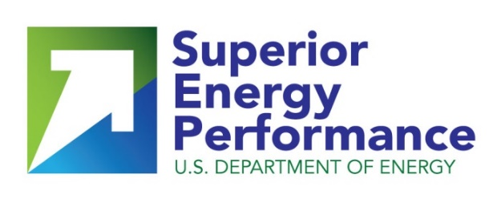


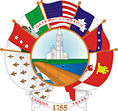

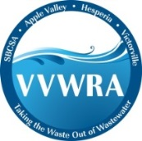
Superior Energy Performance (SEP)
Certification program
ISO 50001 energy management standard
Verifies energy savings achieved
New water utility members:
Notes:
Complementary to the Better Plants initiative is the Superior Energy Performance Program. Many organizations join both programs to drive progress toward their corporate-level goals.
Superior Energy Performance (SEP) offers plant-level certification, while Better Plants partners make corporate-wide commitments.
To achieve certification under SEP, plants must implement energy management systems consistent with ISO 15,001 and achieve a set level of third-party verified energy savings.
General SEP results to date (for industrial plants, not water resource recovery facilities) include:
33 plants certified,
Average energy performance improvement of 11% in 18 months, and
Savings over $500,000 per year.
For water resource recovery facilities:
Six have committed to working toward SEP (4 of them are also Better Plants partners).
DOE established a cohort and will fund the energy management training for this group.
DOE will share solutions with the market.
The six participating agencies include (Better Plants partners in bold):
Delta Diablo Sanitation District (California)
Victor Valley Water Reclamation Authority (California)
Kent County Department of Public Works (Delaware)
Des Moines Metropolitan Wastewater Reclamation Authority (Iowa)
Des Moines Water Works (Iowa)
Ithaca Area Wastewater Treatment Facility (New York)

Slide 14
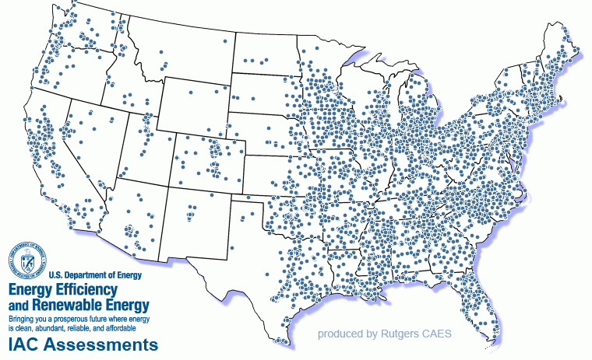
Industrial Assessment Centers (IACs)
24 centers based in universities around the country
FREE assessments for small and mid-sized manufacturers, including water & wastewater plants
IACs (2012-2016)
IAC Assessments (through 2012)
Notes:
To further advance energy efficiency in the industrial sector, DOE funds a network of Industrial Assessment Centers (IACs), housed within 24 engineering schools across the country.
IAC teams are led by professors and staffed by graduate and undergraduate engineering students.
IACs perform free one-day energy audits for small and mid-sized plants , including water and wastewater facilities – available to all plants that meet the program’s size requirements listed below.
These audits make recommendations to reduce energy, water, and waste, increase productivity, and typically uncover 5-10% energy savings within individual plants.
Results to date:
IACs have:
Conducted 61 assessments at water resource recovery facilities,
Identified savings opportunities of about $230,000 on average at each facility, and
On average, IAC clients report $46,000 in 1st-year energy and process improvements savings.
OPTIONAL: If size requirements come up, facilities must meet the following:
Energy expenses between $250k - $2.5M/year,
Water >5 MGD (million gallons per day), and
Wastewater >2 MGD (million gallons per day).

Slide 15
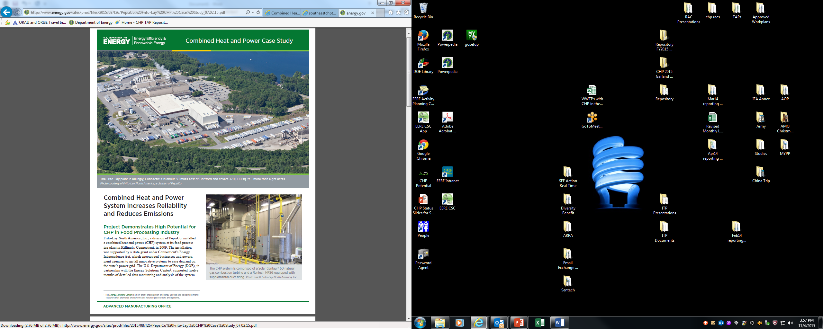
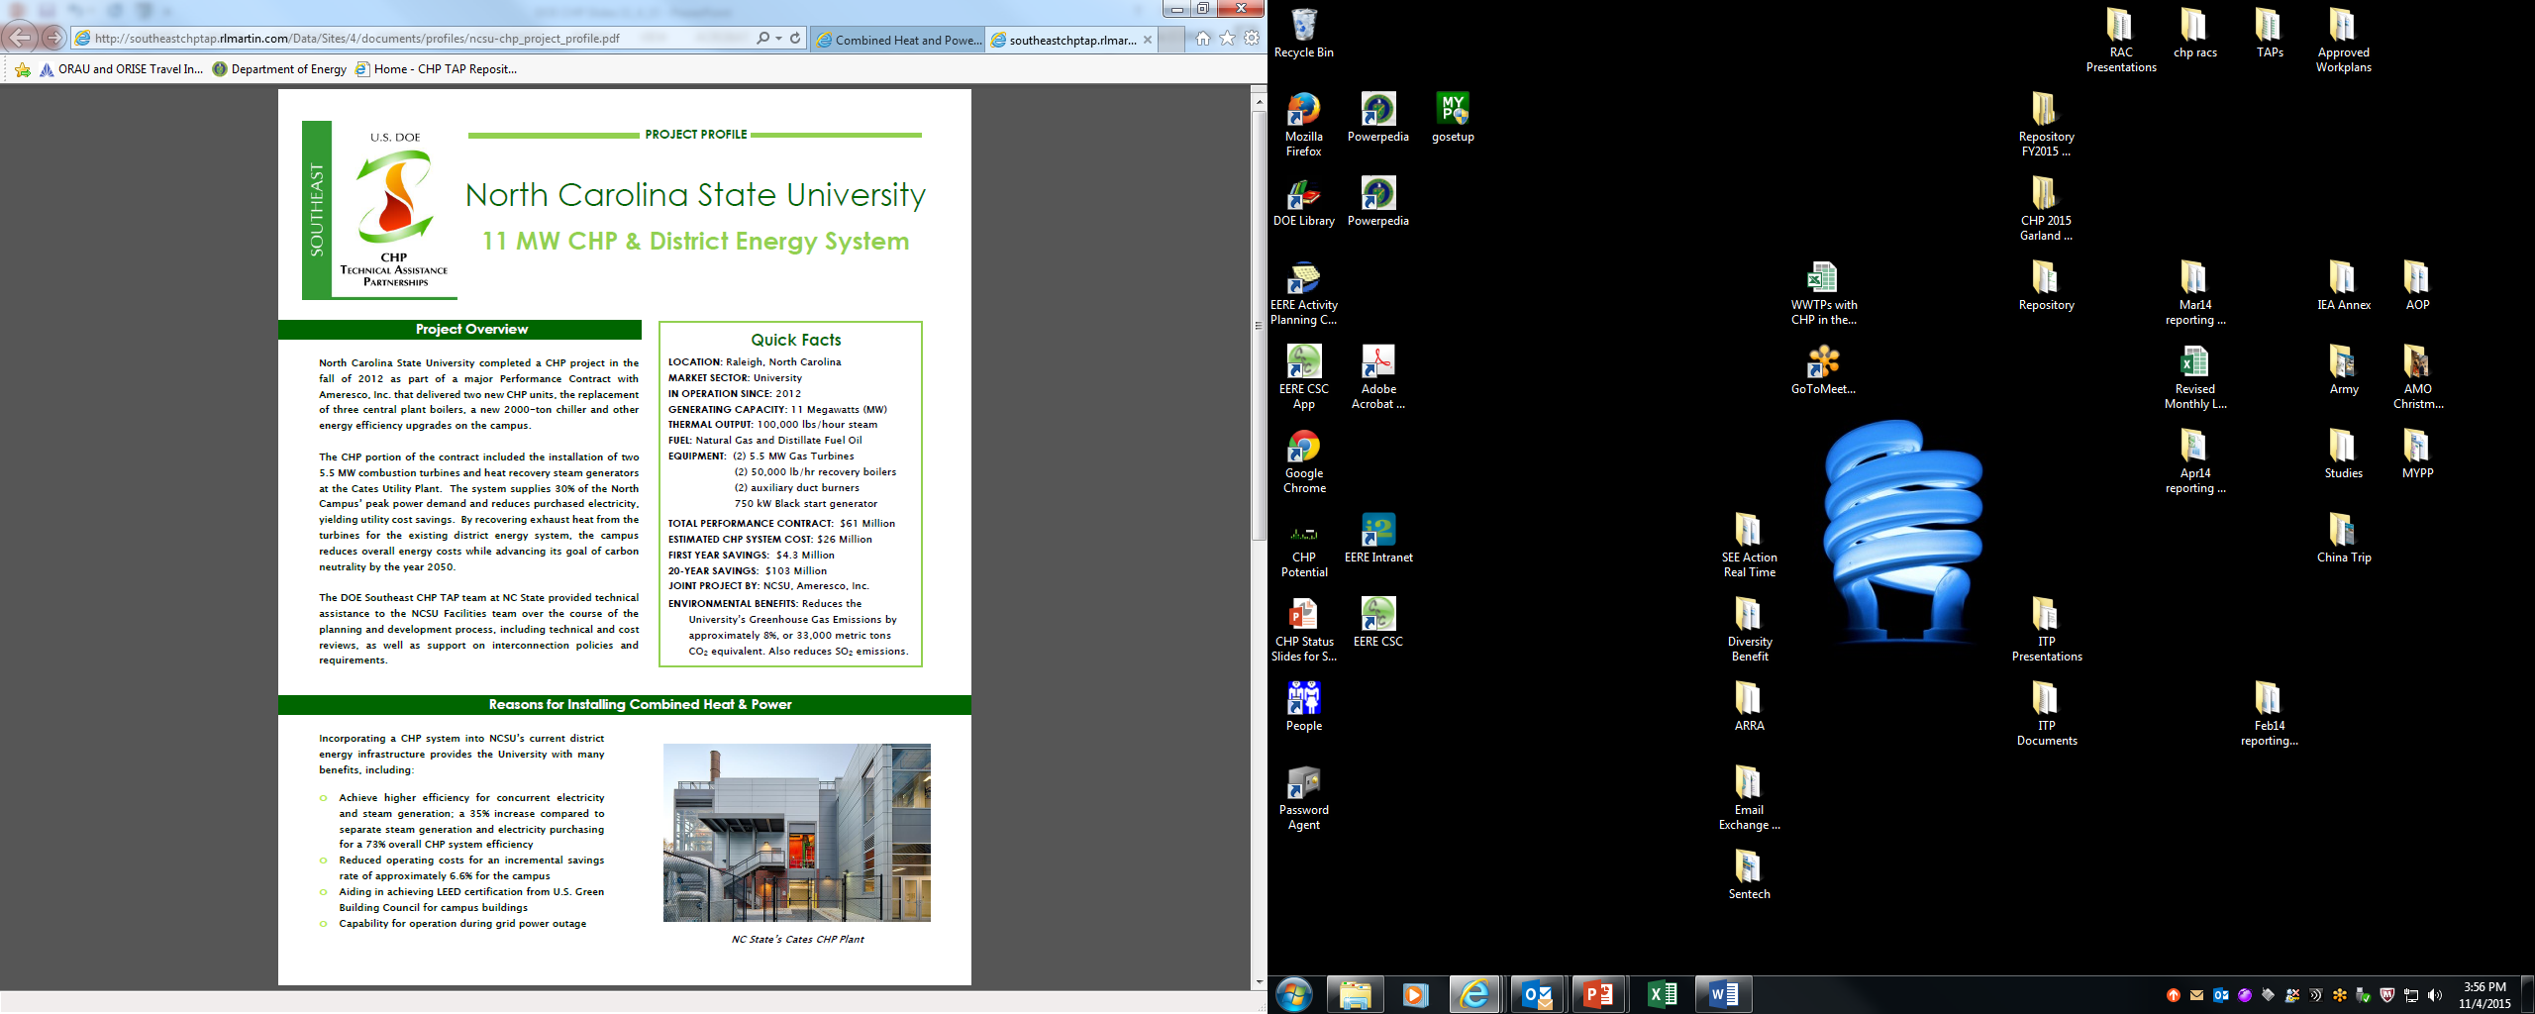
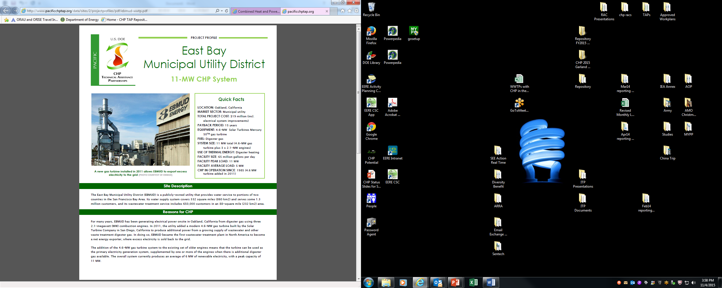
CHP Deployment Program
Program activities include:
Market analysis and tracking
CHP Market Study – Technical Potential
DOE/ICF CHP Installation Searchable Database
Fact sheets, reports, project profiles:
Waste Heat to Power Market Assessment
CHP Project Profile Database
Notes:
CHP can be a key energy solution in the water and wastewater treatment sector, and DOE is especially interested in the opportunity to convert wastewater digester gas to electricity through highly efficiency CHP systems.
DOE’s CHP deployment program can help water resource recovery facilities decide if CHP is right for them:
Provides resources necessary to identify CHP market opportunities, and
Supports installation of CHP systems in water resource recovery facilities.

Slide 16
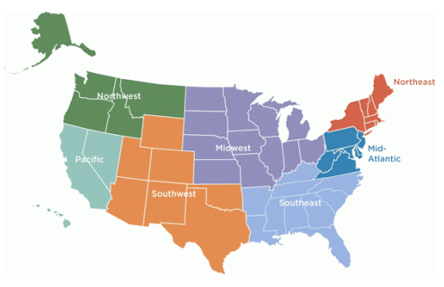
CHP Technical Assistance Partnerships (TAPs)
CHP TAPs provide:
Market Opportunity Analysis
Education & Outreach
Technical Assistance
Free CHP screenings and engineering assistance
Water Resource Recovery Facilities are a Target Market
www.energy.gov/CHP
Notes:
Similar to the IACs, the TAPs are a resource that is open to all plants and water resource recovery facilities regardless of whether they are partnering with DOE through another program.
Facilities receive site-specific technical assistance through seven regional Technical Assistance Partnerships (CHP TAPs) across the country.
TAPs work directly with end-users to help advance cost-effective CHP through:
1. Market assessments for CHP,
2. Education & outreach on CHP to a broad range of stakeholders, and
3. Technical assistance such as project screenings and feasibility analyses.
Results FY2009-2014:
More than 780 projects supported,
More than 220 projects under development or online,
An estimated installed capacity of 1.7 GW, and
15 water resource recovery facility project profiles.

Slide 17
Combined Heat & Power for Resiliency Accelerator
Three-year commitment
Purpose to support and expand the consideration of CHP solutions for critical public infrastructure needs
Partners will create a CHP decision support tool, document models, and publish a community support toolkit
Additional partners welcome!
Long Island, NY
Notes:
We are excited to announce the newest initiative around CHP, the CHP for Resiliency Accelerator.
This was launched at the Better Buildings Summit in May 2016.
There are about 15 partners; and of those, 2 water utility partners to date:
Bath Electric Gas & Water (Bath, NY), and
Miami-Dade Water & Sewer Department (Miami-Dade County, FL).
The goal of this accelerator is to support and expand CHP solutions by states, communities and utilities for their critical infrastructure needs.
Accelerator Activities:
Examine the perception of CHP among resiliency planners, identify gaps in current technologies, and develop plans for communities to capitalize on CHP’s strengths
Establish a dialogue on the current and/or planned usage of CHP in resiliency planning for critical infrastructure (CI), the value propositions for using CHP in CI, and any barriers for CHP in CI at the state, community, and utility levels.
Expand existing or new resiliency plans to include CHP as a solution
Share resiliency action plans that include CHP as a solution option with other communities.
Document replicable models for using CHP as a resilience strategy
Create a decision support tool for assessing and prioritizing the appropriateness of CHP for critical infrastructure facilities within a jurisdiction.
Publish a toolkit to support communities in utilizing CHP as a resiliency solution in critical infrastructure.
Additional partners welcome! Please come and speak with me if you are interested in joining this exciting initiative.

Slide 18
Wastewater Infrastructure Accelerator
Three-year commitment
Purpose to accelerate a pathway to a sustainable wastewater infrastructure
Partners will establish an energy data management approach, assess technical & other measures, consider financing options, and draft model infrastructure improvement plans
Additional partners welcome!
Long Island, NY
Notes:
We are also excited to share another new initiative that is specifically targeted for your sector: the Wastewater Infrastructure Accelerator:
This was also launched in May 2016.
We currently have 9 partners, representing 36 water resource recovery facilities.
The goal is to build sustainable wastewater infrastructure.
Accelerator Activities include:
Establish energy data management approach.
Assemble an infrastructure improvement plan that strives toward at least 30 percent energy savings and ideally integrate at least one resource recovery measure.
Assess technical, management, process, and resource recovery options.
Consider financing options.
And demonstrate energy conservation measures.
Additional partners welcome! Alice Dasek—raise your hand. Alice is the point person for this exciting new initiative. If you are interested in leaning more, come and speak with me or Alice after.

Slide 19
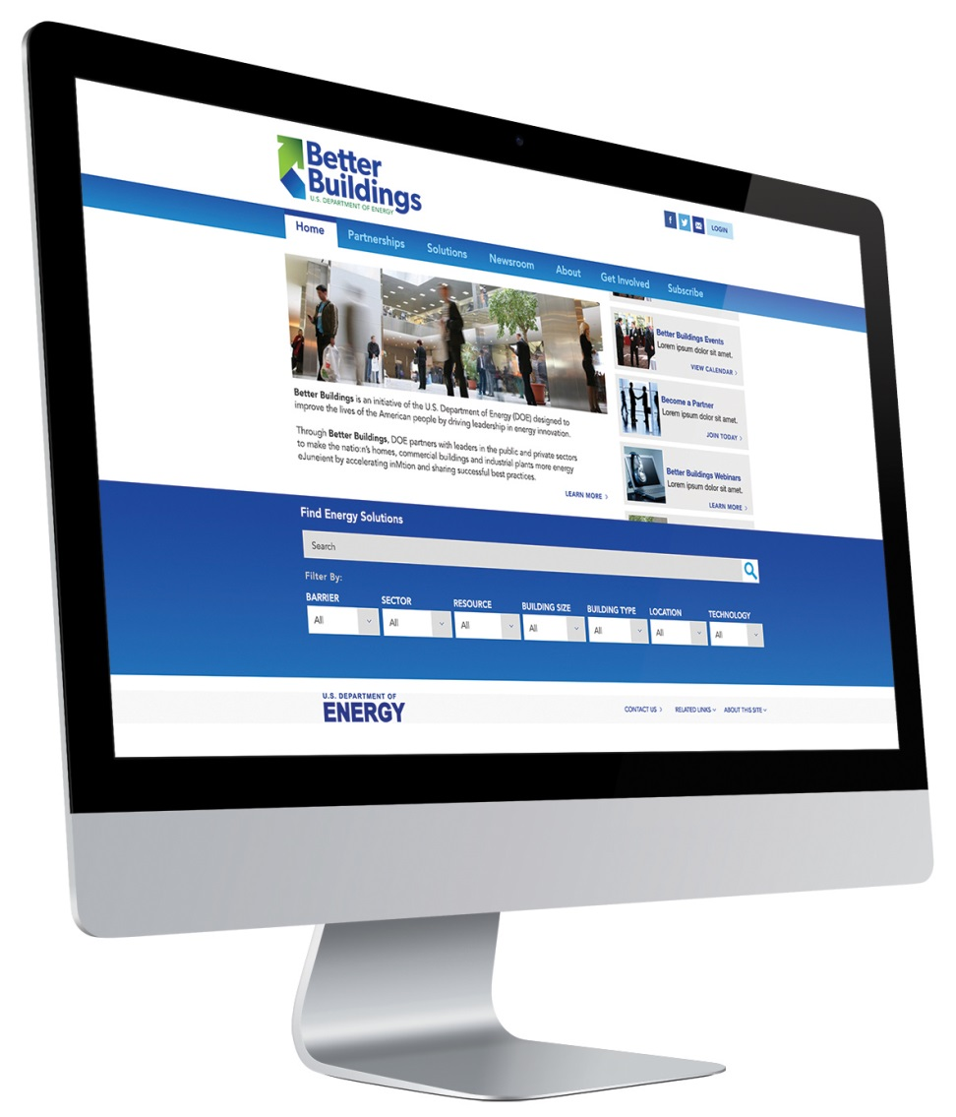
Better Buildings Solution Center
Features 400 solutions tested and proven by partners
Find solutions by topic, building type, solution type, building size, sector, technology, location, and more.
Access showcase projects, including for water resource recovery facilities
http://betterbuildingssolutioncenter.energy.gov/better-plants/all-tools-and-trainings
Notes:
To learn more about all of these initiatives you can also:
Visit the BB Solution Center includes AMO tools at the link on this screen.

Slide 20
Thank You
Alice Dasek
Policy & Technical Assistance
Office of Energy Efficiency & Renewable Energy (EERE)
U.S. Department of Energy
alice.dasek@ee.doe.gov
Notes:
You can also come and talk to me after the presentation or send me an e-mail, and we can connect you to the project officers for the initiatives you’re interested in, and the information at DOE that you need to achieve your goals.
We welcome you to participate in these DOE programs, and look forward to partnering with you!
Thank you so much.

